Slide 1
Big Mountain Resort
A data science approach to setting ticket prices
Student: Dann Albright
Cohort: April '23

Slide 2
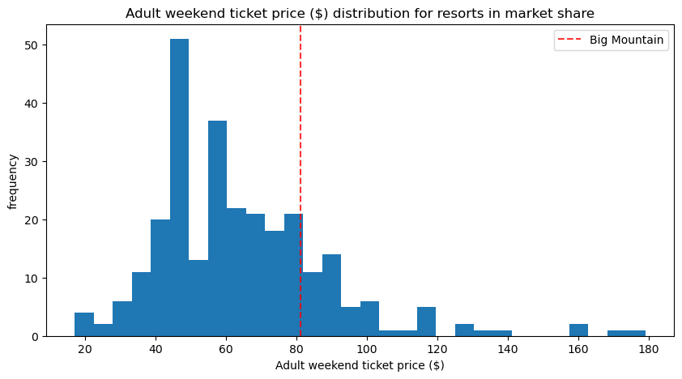
Where we are now
$81 per adult lift ticket
~$141,750,000 revenue
New chairlift: $1,540,000 in operating costs

Slide 3
How can we improve profitability?
Data modeling suggests an increase of $5 in ticket price
Consider closing up to 10 of the least-used runs at the resort
Consider adding a run and increasing resort's vertical drop by 150 ft.

Slide 4
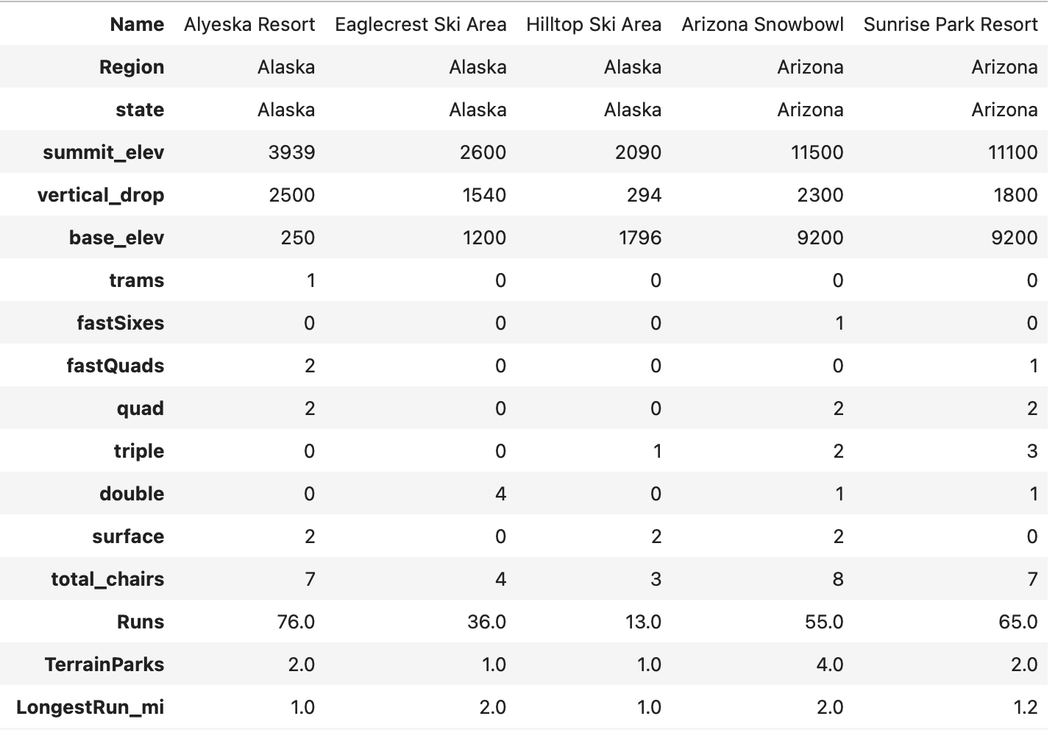
Data analysis and modeling
Data on 330 resorts
After cleaning, 25 features from 277 resorts

Slide 5
Choosing a model
 | Linear regression | Random forest
R² | 0.633 | 0.710
Mean absolute error | $11.79 | $9.54

Slide 6
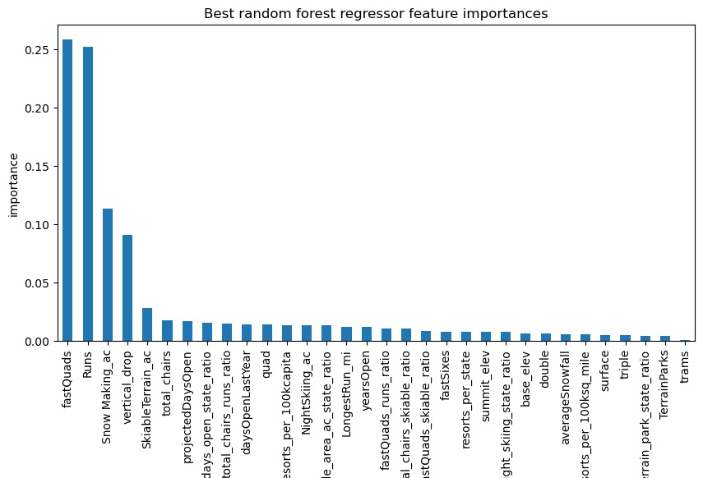
Random forest predictors

Slide 7
Random forest results
Modeled price for Big Mountain Resort adult weekend ticket price: $95.87.
Team suggested adult weekend ticket price: $86.
$8,750,000 in additional predicted revenue.

Slide 8
Cost-saving / revenue-generating tactics
Data modeling suggests looking further into two tactics:
Closing up to 10 of the least-used runs at the resort
Adding one run, 150 ft. of vertical drop, and one chairlift for access

Slide 9
Summary
Data modeling suggests there is room for an adult weekend ticket price increase.
We suggest raising the price from $81 to $86.
Further exploration into cost-saving and revenue-generating measures is warranted.

